Slide 1
Latin
Y8
Wednesday 26th April 2023

Slide 2
 |  | 1st Declension Girl (f) | 2nd Declension Master (m)
Singular | Nominative
 | Accusative
 | Genitive
 | Dative
Plural | Nominative
 | Accusative
 | Genitive
 | Dative

Slide 3
Check your answers! |  | 1st Declension Girl (f) | 2nd Declension Master (m)
Singular | Nominative | puell-a | domin-us
 | Accusative | puell-am | domin-um
 | Genitive | puell-ae | domin-i
 | Dative | puell-ae
Plural | Nominative | puell-ae | domin-i
 | Accusative | puell-as | domin-os
 | Genitive | puell-arum | domin-orum
 | Dative | puell-is

Slide 4
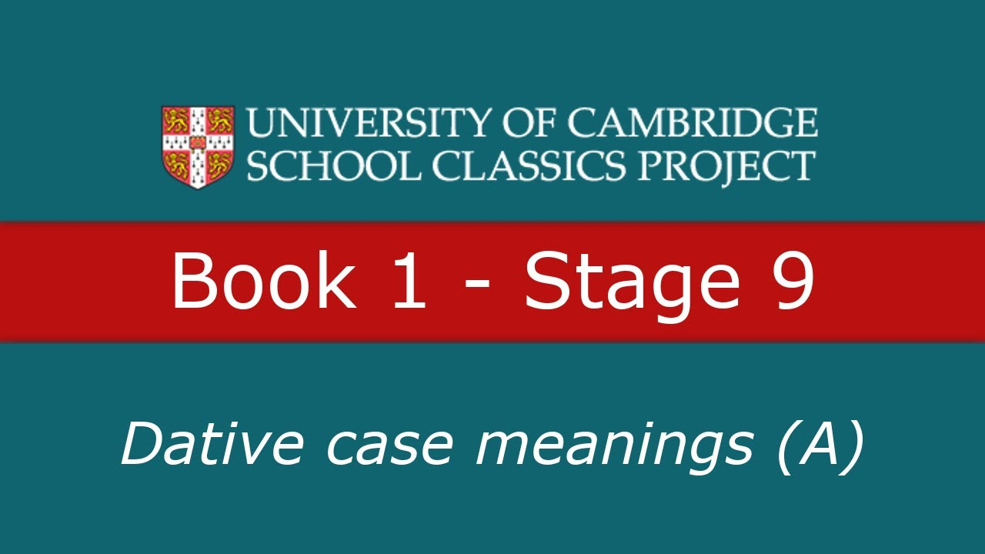
Watch and learn!
Use your headphones to watch the following video

Slide 5
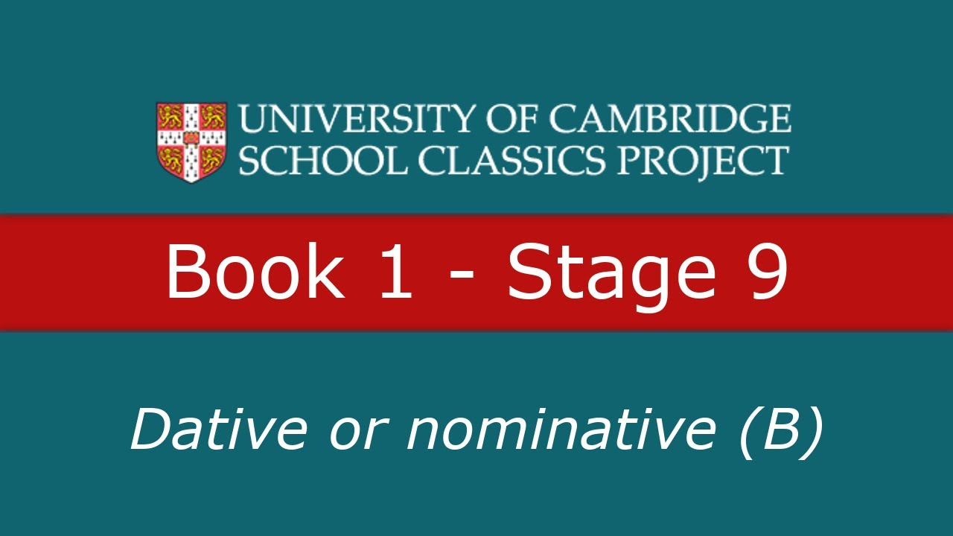
Watch and learn!
Use your headphones to watch the following video

Slide 6
Identifying the dative case
In each of the following sentences, underline the noun in the dative case
The slave was offering a wine cup to the guest.
The girls showed the dog to the slaves.
We went to the shops to find a shirt for the boy.
The shopkeeper sold the ring to the woman.
You gave the sword to me.
The master bought the dress for his wife.
The cook was preparing dinner for the mistress.

Slide 7
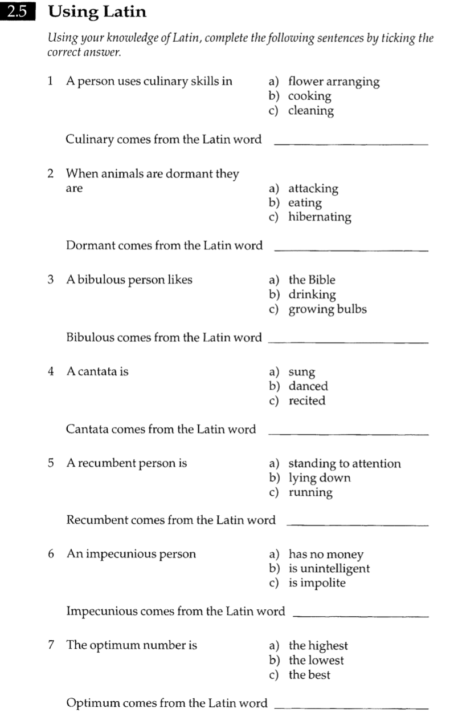
Derivation work
Use your computers to find the answers to the questions on the worksheet

Slide 8
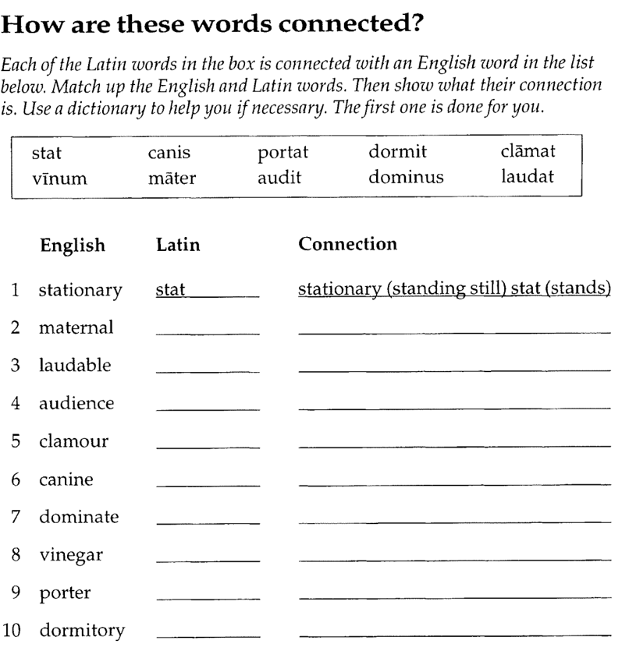
Derivation work
Use your computers to find the answers to the questions on the worksheet

Slide 9
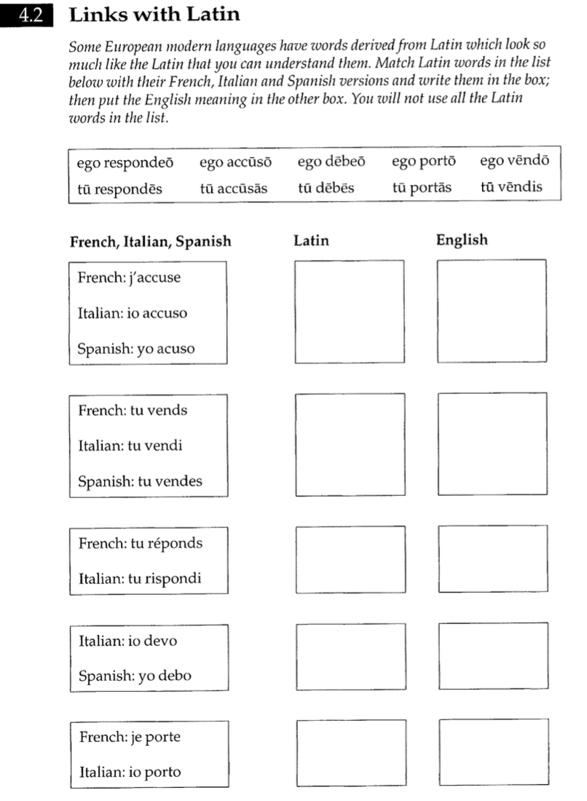
Connections work
Use your computers to find the answers to the questions on the worksheet

