Slide 1
Latin
Y8
Tuesday 25th April 2023

Slide 2
Today
Tuesday 25th April 2023
LO: to translate the dative case and its meaning

Slide 3
 |  | 1st Declension Girl (f) | 2nd Declension Master (m)
Singular | Nominative | puell-a | domin-us
 | Accusative | puell-am | domin-um
 | Genitive | puell-ae | domin-i
 | Dative | puell-ae
Plural | Nominative | puell-ae | domin-i
 | Accusative | puell-as | domin-os
 | Genitive | puell-arum | domin-orum
 | Dative | puell-is

Slide 5
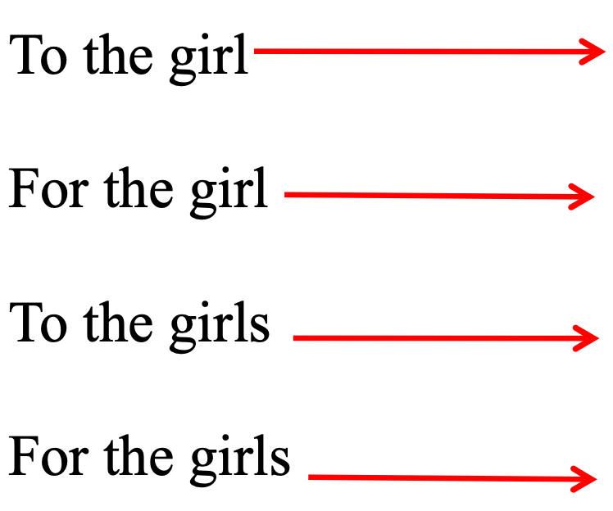

Slide 6
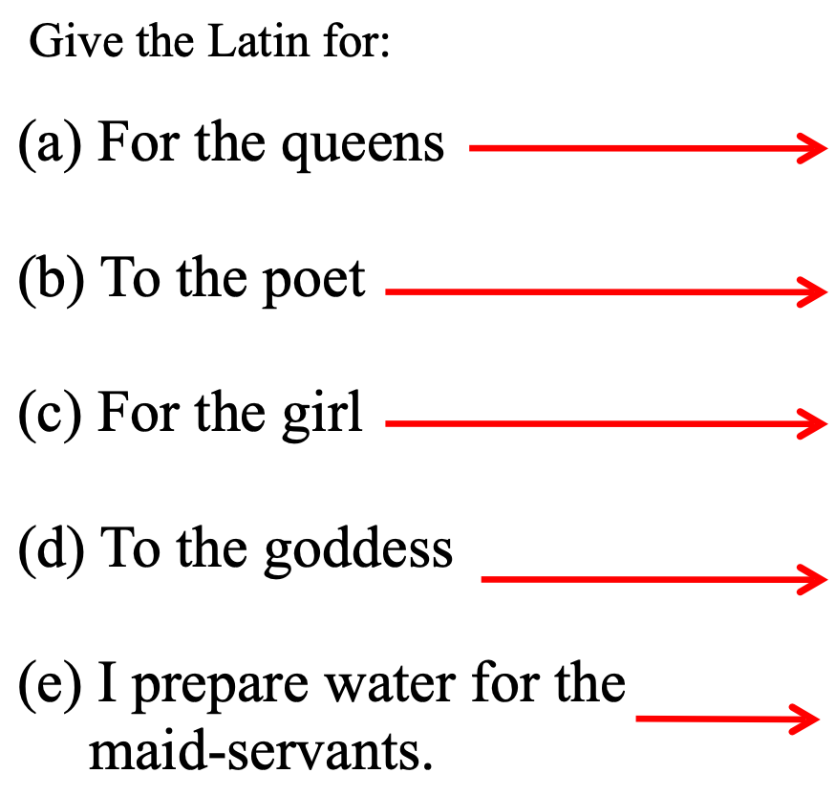

Slide 7
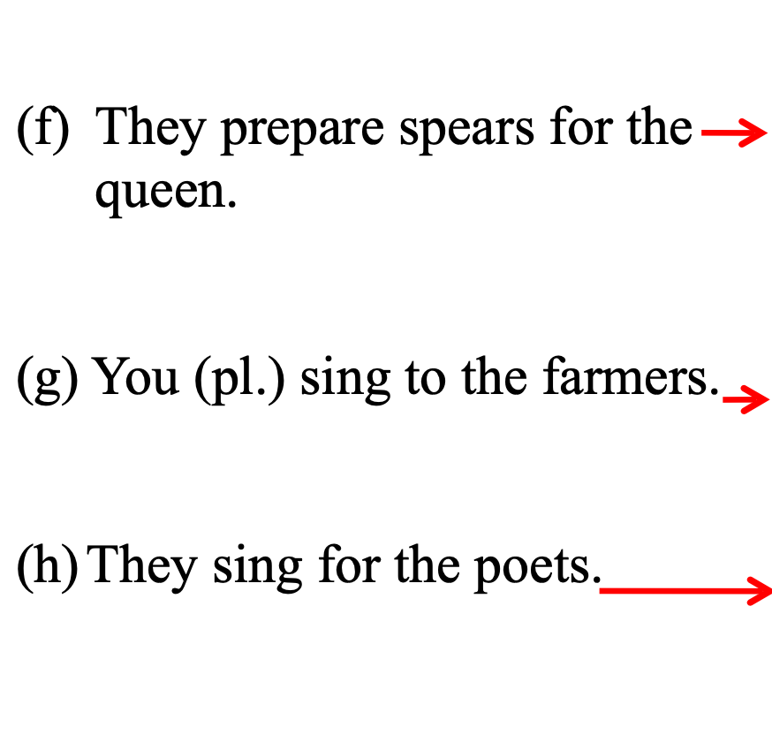

Slide 8
Draw a table in your book like the one below
Sort the nouns on the next slide into the relevant boxes
 | 1st declension | 2nd Declension
Nominative
Accusative
Genitive
Dative
Nominative
Accusative
Genitive
Dative

Slide 9
Put these nouns into the correct place in the table you have drawn
Remember that some nouns could go in a few places, depending on similar endings!
ancilla
servi
dominorum
aquae
sagittarum
agricolae
equum
puellas
hastam
coquus
servos
feminae
nautis

Slide 10
The dative case: To whom? For whom?
For each of the following sentences, circle the correct form of the noun
ancilla (agricolae, agricola) pecuniam dat
Metalla (filiis, filias) vocat
dominus (puellis, puellarum) fabulam narrat
servus (dominas, dominae) vinum optimum offert
Vocabulary:
pecuniam = money; fabula = story; narrate = tells; vine = wine; optimum = the best/very good; offers = offers

Slide 11
Online Exercises
Click on the following links to complete the parts of the exercises mentioned
1. Click here to complete the first two drag and drop activities only
2. Click here to complete the first two drag and drop activities only

Slide 12
Home learning
If you finish early you should start to learn the below for tomorrow
Learn the noun table which includes the dative case of the 1st declension

