Slide 1
Latin
Year 8 revision
Tuesday 13th June 2023

Slide 2
LO: revision of grammar we have learnt this year
Tuesday 13th June 2023
Instructions:
Put today’s date and the learning objective in your books.
Underline both of these.
Draw and complete the table on the next slide, then get a green pen and mark it (the answers are on the slide after this - don’t cheat, you want to know what you still need to revise for the exam!

Slide 3
 |  | 1st Declension Girl (f) | 2nd Declension Master (m)
Singular | Nominative | puell- | domin-
 | Accusative | puell- | domin-
 | Genitive | puell- | domin-
 | Dative | puell- | domin-
Plural | Nominative | puell- | domin-
 | Accusative | puell- | domin-
 | Genitive | puell- | domin-
 | Dative | puell- | domin-

Slide 4
 |  | 1st Declension Girl (f) | 2nd Declension Master (m)
Singular | Nominative | puell-a | domin-us
 | Accusative | puell-am | domin-um
 | Genitive | puell-ae | domin-i
 | Dative | puell-ae | domin-o
Plural | Nominative | puell-ae | domin-i
 | Accusative | puell-as | domin-os
 | Genitive | puell-arum | domin-orum
 | Dative | puell-is | domin-is

Slide 5
A recap of cases: write these out in your book
The nominative is used for ________________
The accusative is used for ________________
The genitive is used for ___________________
The dative case is used for ___________________

Slide 6
Draw this table then sort the nouns on the next slide into the relevant boxes
 | 1st declension | 2nd Declension
Nominative
Accusative
Genitive
Dative
Nominative
Accusative
Genitive
Dative

Slide 7
Put these nouns into the correct place in the table you have drawn
Remember that some nouns could go in a few places, depending on similar endings!
In some instances, there are more than one noun to put in a box!
agricola
horti
equorum
puellae
aquarum
feminae
servum
nautas
sagittam coquo
cibus
dominos deis
hastae
villis
gladio
nuntiorum
dearum
epistulam
insulis
incolis
pecunias
Roma

Slide 8
Answer the following question
What are the three ways of translating the present tense in Latin?
Use the verb ‘to carry’ as your example.

Slide 9
Answer the following question
What are the different person endings of verbs? Copy out the table and complete it.
I
You (singular)
He / She / It
We
You
They

Slide 10
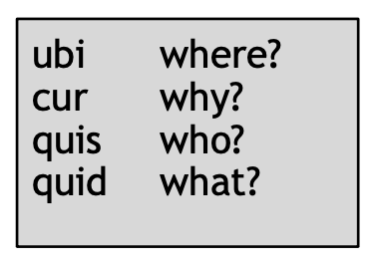
Write 10 of your own questions in
Latin using these question words.
Translate each one.

Slide 11
Write 10 of your own questions in
Latin using ‘ne’.
Translate each one.

Slide 12
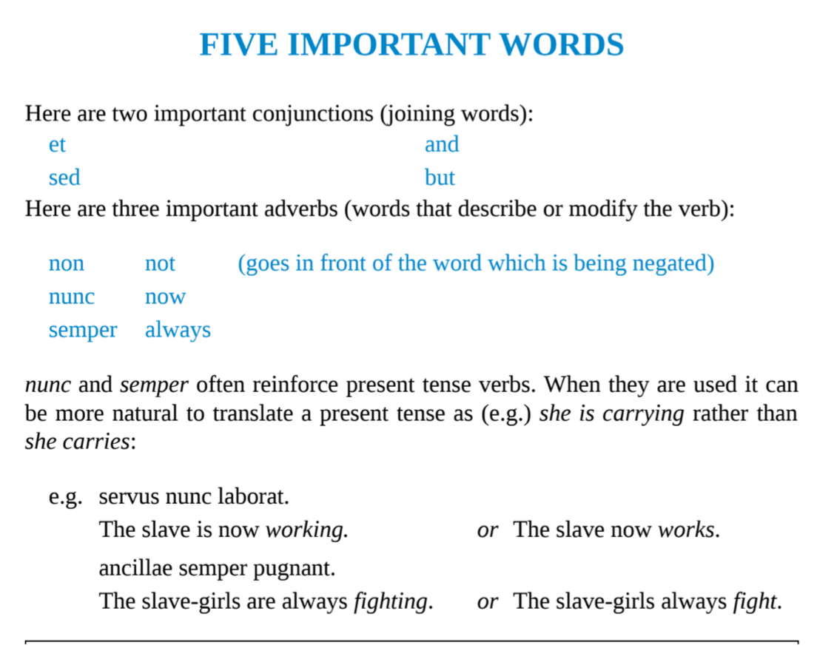
Write 5 sentences in Latin using one of these important word in each sentence.
Translate each sentence into English, too.

Slide 13
The verb ‘to be’
Answer the following question in your books
What is the difference between these in Latin (translate each of these in your books)?
I am a girl
I am walking

Slide 14
The verb ‘to be’
What are the different person endings this verb? Copy out the table and complete it.
I am
You (singular) are
He / She / It is
We are
You are
They are

Slide 15
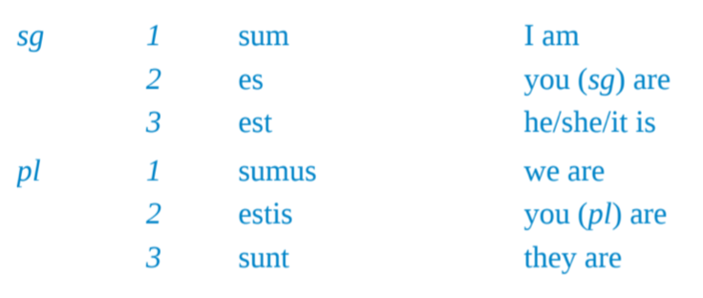
Check your answers!

Slide 16
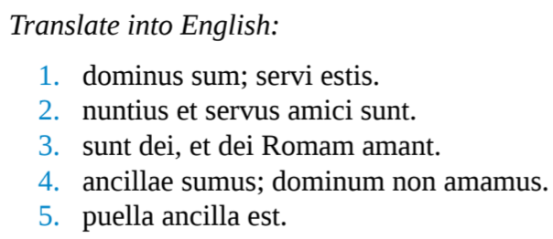

Slide 17
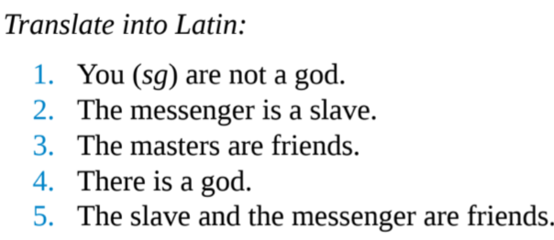

Slide 18
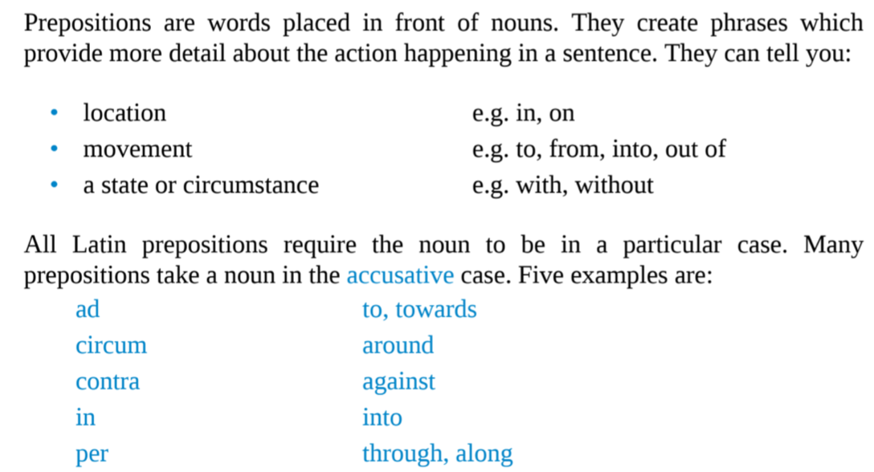
Prepositions

Slide 19
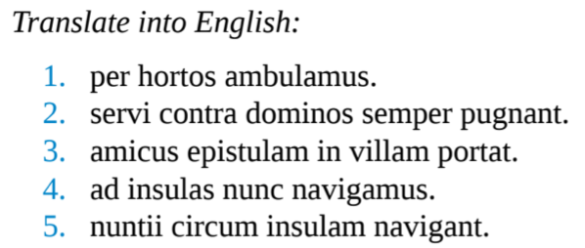

Slide 21
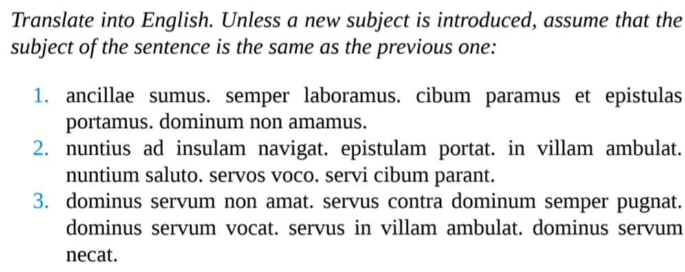

Slide 22
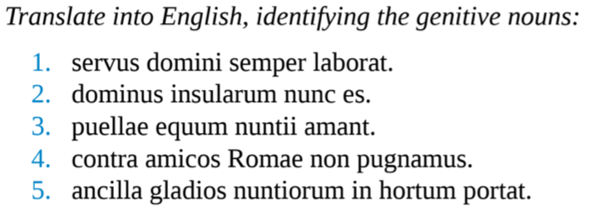

Slide 23
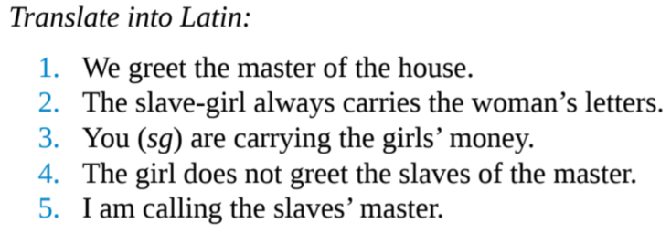

Slide 24
